Slide 1
Customer Churn Analytics And Prediction
2026

Slide 2
The problem
Our data tells a story of interaction and dissatisfaction. This analysis helps us understand those "signals."
Customer retention is crucial in e-commerce. The cost of acquiring a new customer is significantly higher than the cost of retaining an existing one.
Identify factors influencing customer churn.
Segment customers based on the probability of churn.
Develop predictive models to identify high-risk customers early on.

Slide 3
Dataset Overview
Source: Kaggle - "E-commerce Customer Behavior Dataset".
Quantity: 50,000 rows of customer data.
Key Features:
Demographics: Age, Gender, Country, City.
Web Behavior: Session Duration, Pages Per Session, Cart Abandonment Rate.
Interactions: Customer Service Calls, Product Reviews, Social Media Engagement.
Transactions: Total Purchases, Average Order Value, Days Since Last Purchase.
Target Variable: Churned (1: Leave, 0: Stay).

Slide 4
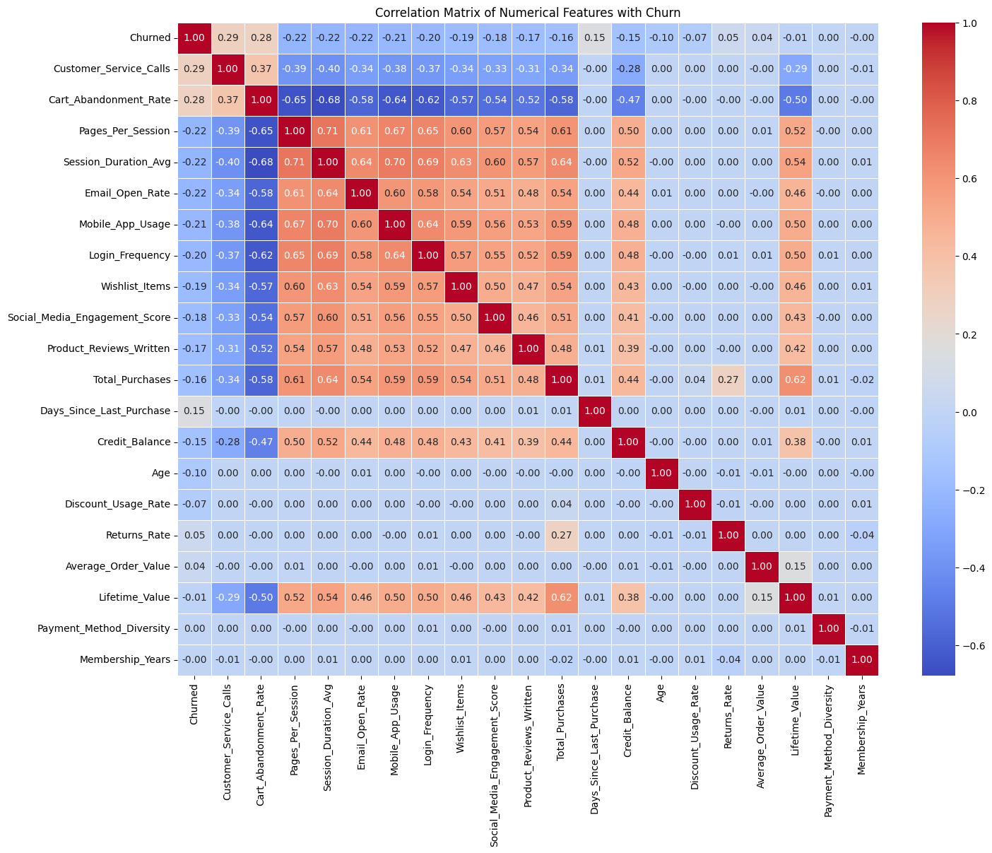

Slide 5
Objective:
To identify which factors are most strongly correlated with customer churn.
Method:
Calculate the Pearson correlation coefficient.
Key findings:
Positive correlation :
Customer_Service_Calls (0.29): The more calls, the more likely customers are to leave.
Cart_Abandonment_Rate (0.28): A high cart abandonment rate is a bad sign.
Negative correlation:
Pages_Per_Session (-0.22) & Session_Duration_Avg (-0.22): More interactions, more loyalty.
Login_Frequency (-0.20): Frequent logins indicate engagement.

Slide 6
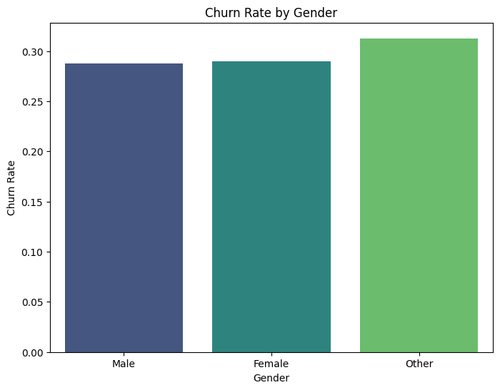
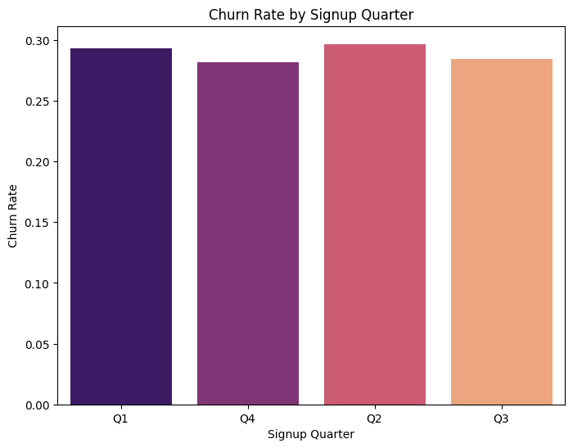
The churn rate showed almost no significant difference between genders or quarters of registration. This suggests that behavioral factors are more important.

Slide 7
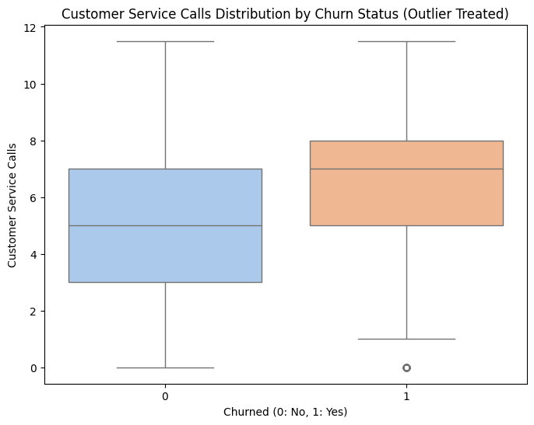
Customers who leave (Churned=1) have a significantly higher median number of support calls. This is a strong indicator of dissatisfaction.

Slide 8
Building Logistic Regression Model
Model of Choice: Logistic Regression. A good, easy-to-interpret, and effective foundational model for binary classification problems.
Preparing data for the model: One-Hot Encoding: Convert categorical variables (Gender, City, Country, etc.) into numerical form.
Standard Scaling: Normalize the variables so they have the same scale.
Data allocation:
80% for the Training set.
20% for the Testing set.
77.6%
0.79
67.9%
42.4%
Recall
Precision
Accuracy
ROC AUC

Slide 9
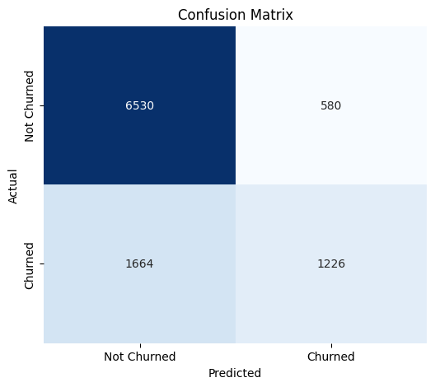
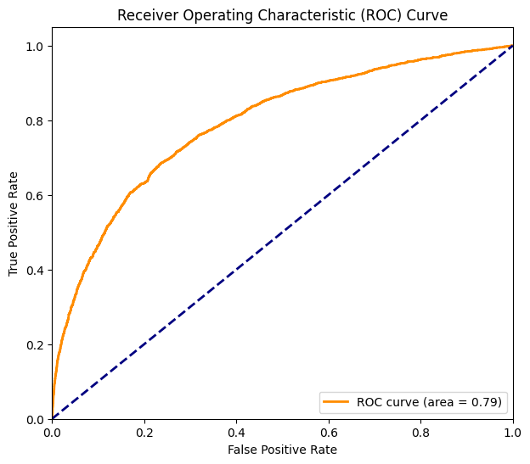
Confusion Matrix và ROC Curve

Slide 10
Results:
Advantages
The model does a very good job of identifying customers who will not leave (True Negatives: 6530).
Disadvantages
The low recall rate (42.4%) is the biggest problem. The model missed a large number of customers who were about to leave (False Negatives: 1664).

Slide 11
SUMMARY:
Conclude:
Interaction behavior (time spent, number of pages, login frequency) and signs of dissatisfaction (support calls, abandoned carts) are the strongest predictors of churn.
Propose:
Customer segmentation and retention:
High-risk segment: Send offers and vouchers to customer groups with a high number of Customer_Service_Calls or a large number of Days_Since_Last_Purchases.
Increase engagement: Create personalized email/push notification campaigns to encourage customers to log in and use the app more frequently.
Monitor "early warning" metrics: Build a dashboard to track key metrics (cart abandonment rate, number of support calls).

Slide 12
Thank you for watching
Q&A

